Slide 1
Office 365 development

Slide 2
Getting started with SharePoint add-ins

Slide 3
Agenda
Intro to the add-in model
SharePoint add-ins
Getting started

Slide 4



Office Platform
WHAT CAN I BUILD?
ADD-INS AND WEB PARTS:
Make your solution a native part of the modern Office
WEB AND DEVICES APPS:
Build smarter apps by connecting to Office services
VOICE, VIDEO, CONNECTORS, AND BOTS
Create the next generation of productivity solutions

Slide 5
1
Intro to the add-in model

Slide 6
Contextual add-ins
Surface your add-ins in the Office 365 platform
In context of your business users productivity activities
In Office Client, Office Online, and modern apps

Slide 7
Introducing the add-in model
SharePoint add-ins do not “live” on the SharePoint server
Custom code executes in the client, cloud, or on-premises
Add-ins are granted permissions to SharePoint via OAuth
Add-ins communicate with SharePoint via REST/CSOM
Acquire add-ins via centralized location
Add-in catalog
Public store (via submission process)
APIs for manual deployment
Notes:
To address many of the challenges developers and site owners had in previous versions of SharePoint, Microsoft has introduced a new development option for SharePoint 2013: The SharePoint Add-in Model.
In this new model Add-ins do not necessary live within SharePoint. Instead the Add-in’s business logic executes within the context of the client (browser) or externally from SharePoint. This external option could be another non-SharePoint Web server or a cloud server. Add-ins are also more secure in that when they need to access SharePoint resources such as lists and libraries they must be explicitly granted permissions to do so. This is implemented using OAuth. When an Add-in is created, the developer specifies which permission the Add-in needs in order to function. When the Add-in is installed, the user installing the Add-in is prompted to accept the permission requests the Add-in needs (if they deny the permissions, the Add-in is not installed). Once granted permissions, the Add-ins can then talk to SharePoint using the Client Side Object Model (CSOM) or using some of the new OData services in SharePoint.
Developers can build Add-ins and submit them to a marketplace making it easy for customers to acquire these applications.

Slide 8






Modern app development
Products and platforms
Add-ins
Services and data
Expense
calculator
Vacation
request
Event
planning
Help-desk
support
Learning management
Risk
management
Add-in catalog and store
Notes:
It’s worth spending some time taking you through how we think about modern app development at Microsoft. We have a series of products and platforms like SharePoint and Office that provide a lot of great out-of-the box functionality to help us be productive. To get even more from these products we want to be able to bring information in from other places. Services and data sources like Dynamics, Bing or something that lives out on the web or in the cloud.
With the latest version of SharePoint we’re making it easier to bring together rich web services and data to create powerful new Add-ins. Add-ins run outside of the SharePoint process, are hosted externally and can be exposed through REST API’s.
Today there are more than 700,000 SharePoint application developers and with this release we’re providing them with a place to surface their Add-ins through an online marketplace of rich partner solutions and applications designed to work with SharePoint and Office.

Slide 9
Demo Adding your first add-in
1 Intro to the add-in model
Notes:
Open SharePoint and add an Add-in from the Office Store (ex: Weather Widget, Tiny Links, etc)

Slide 10
2
SharePoint add-ins

Slide 11
SharePoint building blocks
Lists/Libraries
Web parts
Site columns
Content types
Remote event receivers
Workflows

Slide 12
Architecture of add-ins
SharePoint
Azure
Web application
Add-in 2
Web
Add-in 2
SQL
Add-in 2
Worker
Site collection
Root site
Apache
Add-in 1
SP hosted
Add-in 2
Provider hosted
Add-in 3 Provider hosted
Add-in 3
Web
Add-in 3
MySQL
Add-in 3
Worker
Sub site
IIS web server
Add-in 3
Provider hosted
Add-in 4
Provider hosted
Add-in 4
Web
Add-in 4
SQL
Add-in 4 Windows service

Slide 13
Client-side pattern
SharePoint environment
Site collection
Lists
Site pages
CSS files
JavaScript files
Host web
Add-in web
Notes:
The client-side pattern typically involves adding HTML pages, CSS files and JavaScript files to the Add-in web. This makes it possible to add client-side code behind the pages of your Add-in. You can also add quite a few other elements to the Add-in web as well. Here is a short list of what you can add.
Site columns
Content types
List definitions
List instances
Site Pages
Web Part Pages
Web Parts
Custom Master Pages

Slide 14
Server-side pattern
SharePoint environment
Site collection
ASP.NET environment
On-premises or in Microsoft Azure
SQL server
On-premises data
Host web
Remote
web
Managed code
C# or VB
IFrame
SQL server
Cloud-based data
Add-in web
Remote
web
Managed code
C# or VB
IFrame
Client-side object model calls
Notes:
The server-side pattern is great for experienced .NET developers because they are able to write strongly-typed code using C# and VB.NET. You also have the flexibility of picking your preferred execution environment (e.g. .NET 4.0, .NET 4.5, etc.) and not being constrained by all the frustrating limitations if running code inside the SharePoint environment.
In some scenarios, the external application associated with a SharePoint Add-in will be self-contained which means it has not need to call into SharePoint to access content. In other scenarios, the external application associated with a SharePoint Add-in will be required to call back into SharePoint to read and write content such as list items and/or documents within the host web or the Add-in web.

Slide 15
Hybrid pattern
SharePoint environment
Site collection
ASP.NET environment
On-premises or in Microsoft Azure
SQL server
On-premises data
Host web
Remote
web service
Managed code
C# or VB
Custom JavaScript
SQL server
Cloud-based data
Add-in web
Remote
web service
Managed code
C# or VB
Custom JavaScript
Client-side object model calls
Notes:
The server-side pattern is great for experienced .NET developers because they are able to write strongly-typed code using C# and VB.NET. You also have the flexibility of picking your preferred execution environment (e.g. .NET 4.0, .NET 4.5, etc.) and not being constrained by all the frustrating limitations if running code inside the SharePoint environment.
In some scenarios, the external application associated with a SharePoint Add-in will be self-contained which means it has not need to call into SharePoint to access content. In other scenarios, the external application associated with a SharePoint Add-in will be required to call back into SharePoint to read and write content such as list items and/or documents within the host web or the Add-in web.

Slide 16
Provider versus SharePoint hosted
Provider hosted add-in
SharePoint hosted add-ins
Preferred hosting model for almost all types of add-ins
Good for smaller add-ins and resource storage
Full power of web—choose your infrastructure and technology
SharePoint-based; no server-side code
May require your own hosting
Automatically hosted in SharePoint
May require you own handling of multitenancy and permission management
Inherent multitenancy and isolation

Slide 17
Add-in isolation
When add-ins are provisioned, new SPWeb (add-in web) created within hosting SPWeb
Each add-in resides within it’s own SPWeb for isolation
Special DNS address configured by administrators
Add-in SPWeb’s live in separate domain (DNS)
Each add-in hosted on it’s own unique URL because
Blocks XSS: isolation to special SPWeb under special domain blocks cross site scripting
Enforces add-in permissions: add-ins communicate with sites via CSOM/API and must be granted permissions to do so
Notes:
When an Add-in is installed, SharePoint creates a special SharePoint site (SPWeb) for the Add-in. This site, called an Add-in Web, is given it’s own top-level URL that is different from the hosting site. This unique URL enforces two things:
Blocking cross site scripting (XSS) – because the hosting site & the Add-in Web are in different domains, browsers will block any script that tries to access resources in different domains.
Enforcing Add-in Permissions – Add-ins will only be allowed to access SharePoint sites if they have been granted access to do so and when they do, they can access it using the CSOM or OData APIs.

Slide 18
Understanding the add-in URL
Scenario:
Add-in installed in https://intranet.contoso.com
Dissecting the add-in URL:
https://tenant-AppUID.domain.com/AppNAME
https://app-bf473b5225nn0f.contoso.com/SharePointAppTitle
AppUID
AppNAME
Unique ID given to each add-in installation in tenancy
Makes each add-in domain unique
Name of SPWeb under where add-in is installed
Developers have control
Notes:
Consider an Add-in installed in the SPWeb http://intranet.contoso.com
The Add-in URL will be (for example): http://App-bf473b5225nn0f.Apps.contoso.com/SharePointAppTitle
Dissecting the Add-in URL (use http://fabrikam-AppUID.SharePoint.com/AppNAME in the following explanation):
AppUID: A unique 14 character identifier that is given to each Add-in installation in that particular customer / tenancy. This makes the domain unique for each Add-in.
AppNAME: The name of the SPWeb folder under which the Add-in is installed. Currently this is a GUID and is automatically generated.
On-Premises Deployment:
In the case of an on-premise deployment, everything in the domain except AppUID is configurable by the administrator; administrators can specify tenant & domain.com in the above scenario. This is set once while preparing the farm to support Add-ins.
Developers have control over the AppNAME within the AppManifest file of the Add-in package.
Add-ins should be used with SSL when deployed to production.
Hosted / Office 365 Deployment:
In the case of a hosted deployment, the customer name (or tenant name) is determined when they create their account with Office 365 and it is not changed after that. The root domain (domain.com in the above scenario) is always SharePoint.com.

Slide 19
Add-in entry points
Add-in entry points
Start page
Add-in parts
UI custom commands
Popup
The Chrome Control
Use the Chrome Control to inherit style and links from the host web in a cloud add-in
Notes:
20488A
08: Introducing SharePoint Add-ins

Slide 20
The SharePoint client APIs
Lists and libraries
User profile
Search
Taxonomy
Feeds
…
_api
Execute query
REST/ OData
JavaScript library
Silverlight library
.Net CLR library
Custom client code

Slide 21
Add-in scoping
Web scope
Can register and use resources in parent site, site collection
Tenant scope
Can register start page, custom actions
Tenant admins can filter-enable on sites
By site collection, managed path, template type
(SharePoint-hosted tenant-scope add-ins not available)
Notes:
Another consideration when building Add-ins involves the scope of the Add-in. Will the Add-in be scoped to a SharePoint site (or a web) as a document library is, or will it be tenant scoped. Tenant scoped means that the Add-in may contain data for multiple tenants (customers) and partition each experience per customer.
Tenant scoped Add-ins can not reside in SharePoint… these types of Add-ins can only be implemented as cloud apps.

Slide 22
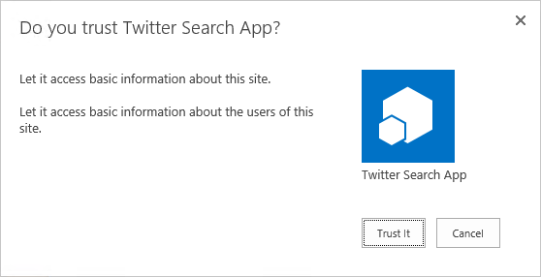
Add-ins in site collection hierarchy
1
3
Add-in
2
2
https://*.contosoApp.com
4
https://intranet.contoso.com/sites/team
4
Root
https://intranet.contoso.com/sites/groupx
Sub site
Add-in web
Root
News
Organization
Teams
Search
Add-in web

Slide 23
Centrally deployed add-ins
1
3
Add-in
2
https://*.contosoApps.com
https://intranet.contoso.com/sites/catalog
Root
https://intranet.contoso.com/sites/team
Add-In web
Add-In web
Root
4
Sub site
https://intranet.contoso.com/sites/orgZ
4
Root
News
Organization
Teams
Search
Add-In web

Slide 24
Packaging and publishing add-ins
Packaging add-ins
.app file extension—a package typically includes the following files:
AppManifest.xml
AppIcon.png
Solution file
Data tier application package
Auto hosted apps
Publishing add-ins
Office Store
Add-in catalogs
Notes:
20488A
08: Introducing SharePoint Add-ins

Slide 25
Cross domain calls
Using the cross domain library
Access content in the add-in web from JavaScript in a remote web
SP.RequestExecutor.js
AppWebProxy.aspx
Using the web proxy
Access content in SharePoint or elsewhere from JavaScript in a remote web
SP.WebRequestInfo
Trusting domains for cross domain calls
Notes:
20488A
08: Introducing SharePoint Add-ins

Slide 26
Versioning
SharePoint
Azure
Web application
Add-in 2
Web
V3.0.0.0
Add-in 2
SQL
V3.0.0.0
Add-in 2
Worker
V3.0.0.0
Site collection
Root site
Apache
Add-in 1
V3.0.0.0
Add-in 2
V3.0.0.0
Add-in 3 V3.0.0.0
Add-in 3
Web
V3.0.0.0
Add-in 3
MySQL
V3.0.0.0
Add-in 3
Worker
V3.0.0.0
Sub site
IIS web server
Add-in 3
V2.0.0.0
Add-in 4
V2.0.0.0
Add-in 4
Web
V2.0.0.0
Add-in 4
SQL
V2.0.0.0

Slide 27
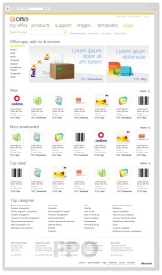
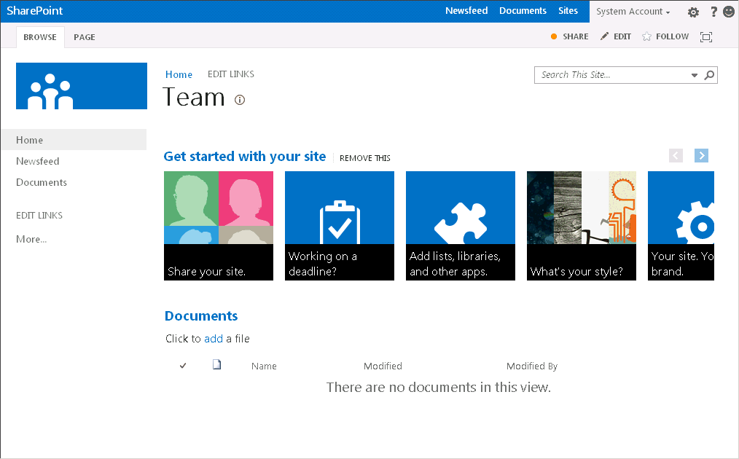
SP Add-in upgrade process
Meetings add-in
V2.0.0.0
Marketplace
Add-in 1.0.0.0
Meetings Add-in
V1.0.0.0
Add-in 1.0.1.0
Meetings add-in
V2.0.0.0
Meetings Add-in
V1.0.0.0
Child Site A
Parent site
Child Site B
Child Site C
New version available

Slide 28
SharePoint add-ins A new way to build extensions for SharePoint
Full Page add-ins
Implement complete app experiences to satisfy business scenarios
Add-in parts
Create web parts that can interact with the SharePoint experience
Add-in commands
Add new commands to the ribbon and contextual menus
SharePoint dialog
Create contextual dialog from ribbon commands and item menus

Slide 29
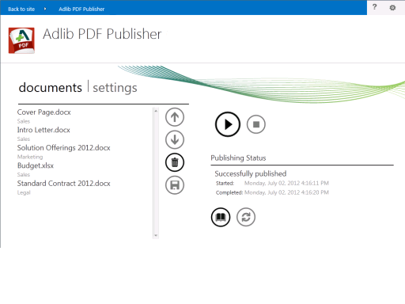
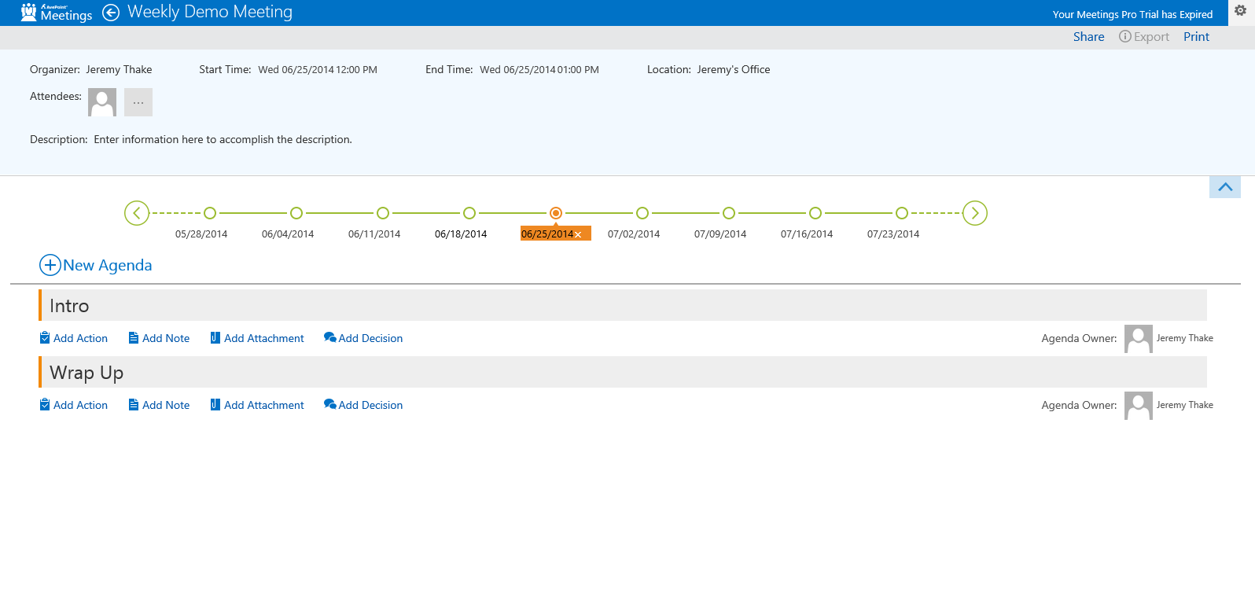

Slide 30
SharePoint add-ins A new way to build extensions for SharePoint
Full page add-ins
Implement complete add-in experiences to satisfy business scenarios
Add-in parts
Create web parts that can interact with the SharePoint experience
Add-in commands
Add new commands to the ribbon and contextual menus
SharePoint dialog
Create contextual dialog from ribbon commands and item menus

Slide 31
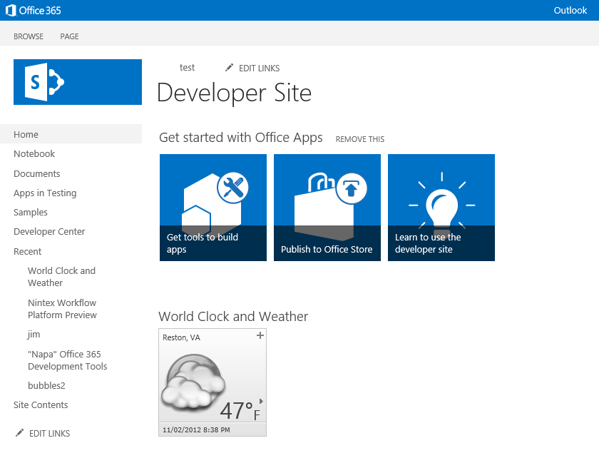
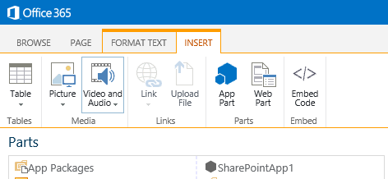

Slide 32
SharePoint add-ins A new way to build extensions for SharePoint
Full page add-ins
Implement complete add-in experiences to satisfy business scenarios
Add-in parts
Create web parts that can interact with the SharePoint experience
Add-in commands
Add new commands to the ribbon and contextual menus
SharePoint dialog
Create contextual dialog from ribbon commands and item menus

Slide 33
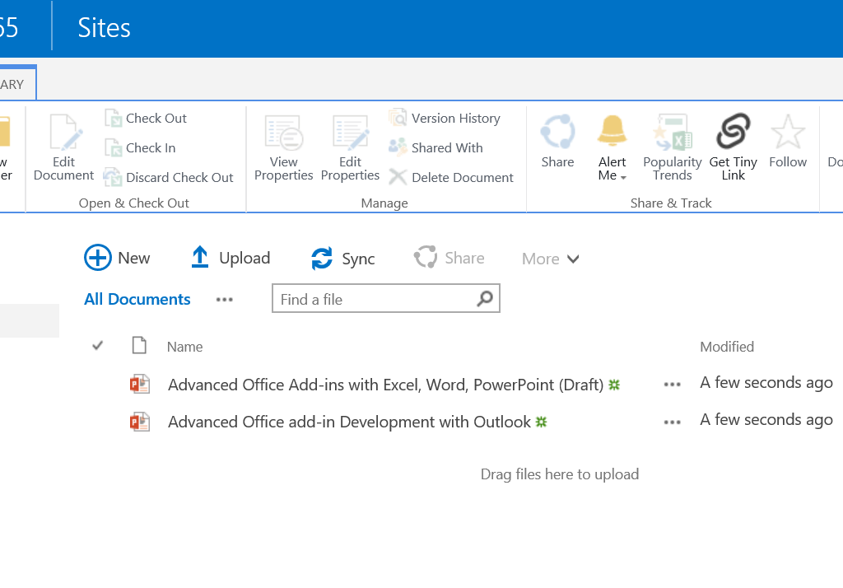

Slide 34
SharePoint add-ins A new way to build extensions for SharePoint
Full page add-ins
Implement complete add-in experiences to satisfy business scenarios
Add-in parts
Create web parts that can interact with the SharePoint experience
Add-in commands
Add new commands to the ribbon and contextual menus
SharePoint dialog
Create contextual dialog from ribbon commands and item menus

Slide 35
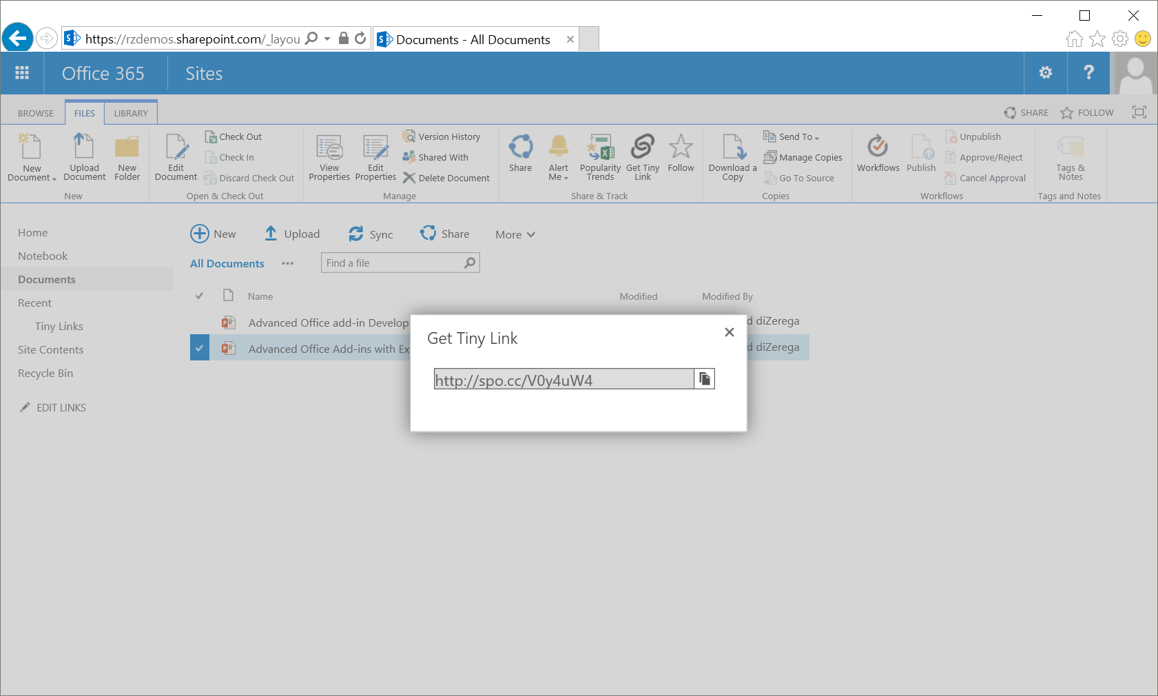

Slide 36
SharePoint add-ins samples
2 SharePoint add-ins
Demo

Slide 37
3
Getting started

Slide 38
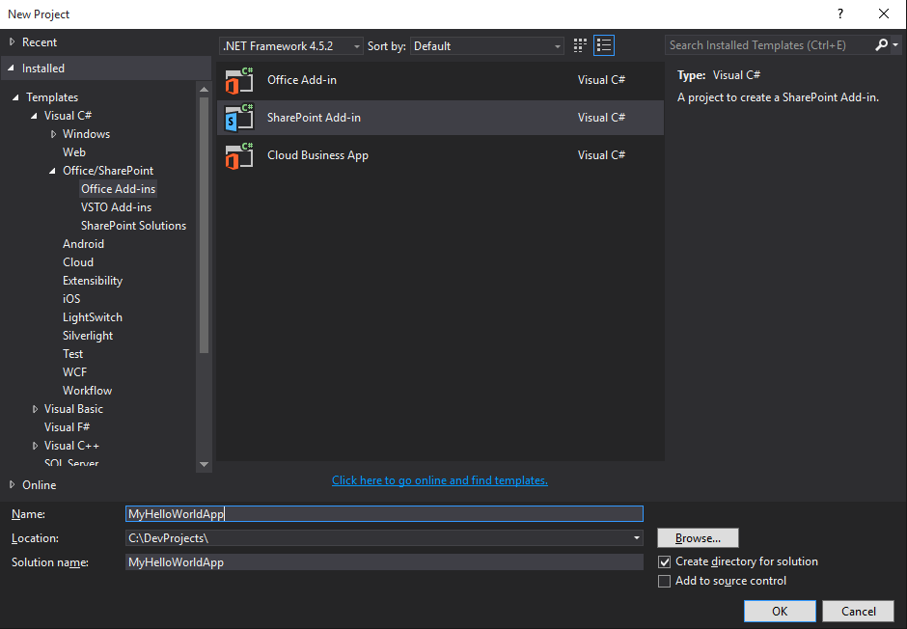
Visual Studio 2015

Slide 39
Environment
Office 365 developer tenant
Office 365 individual developer site collection
On-premises SharePoint server

Slide 40
Building your first SharePoint add-in
3 Getting started
Demo

Slide 41
Conclusion
Surface your business solutions in Office 365 user interface
Leverage the building blocks of the platform
Use the development platform of your choice

Slide 42
Summary
Intro to the add-in model
SharePoint add-ins
Getting started

Slide 43
Further reading…
SharePoint Code Samples
SharePoint Training videos & hands on labs
SharePoint documentation
SharePoint patterns and practices solution guidance

Slide 44
Engage

